Slide 1

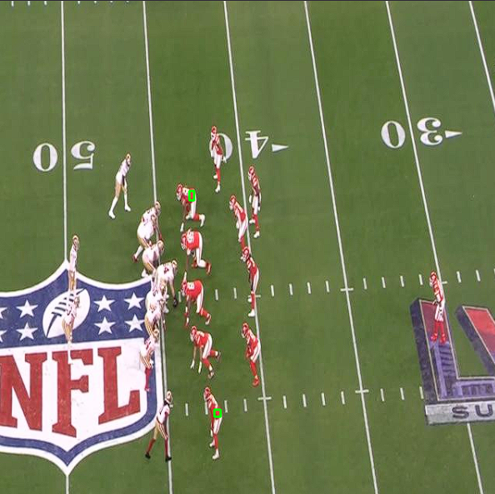
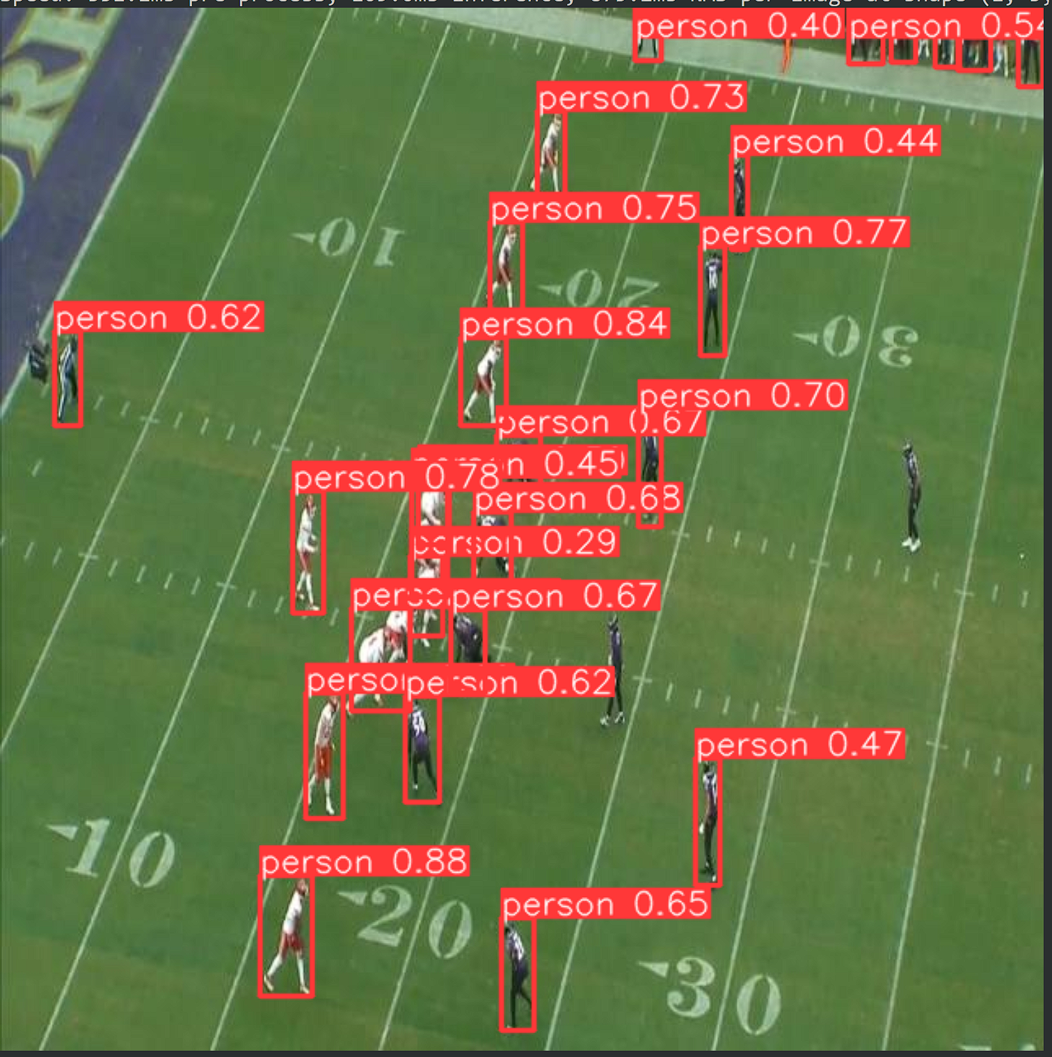
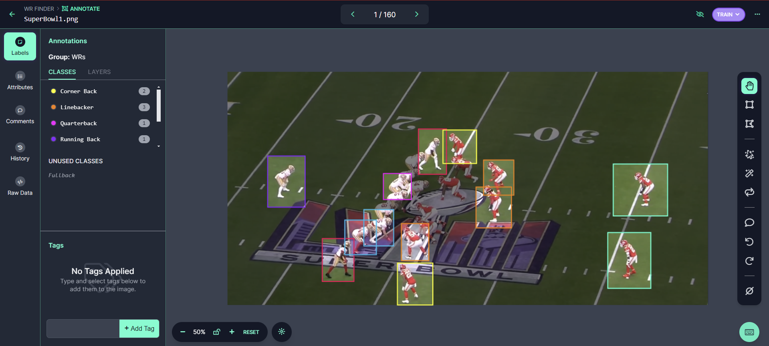
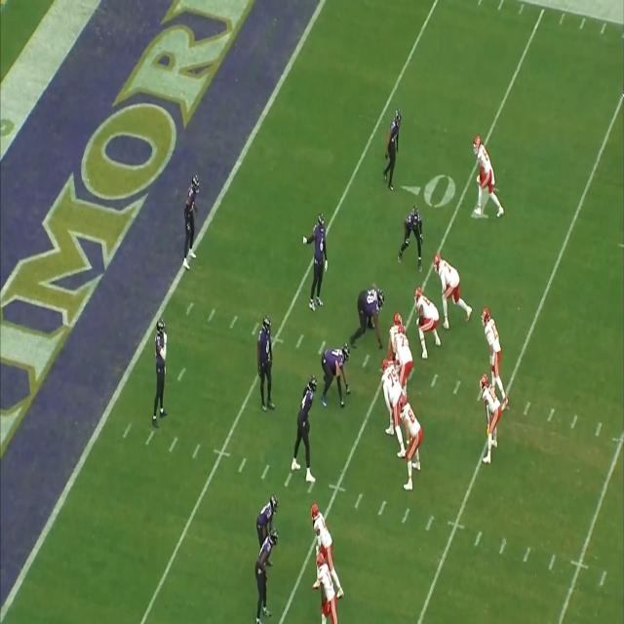
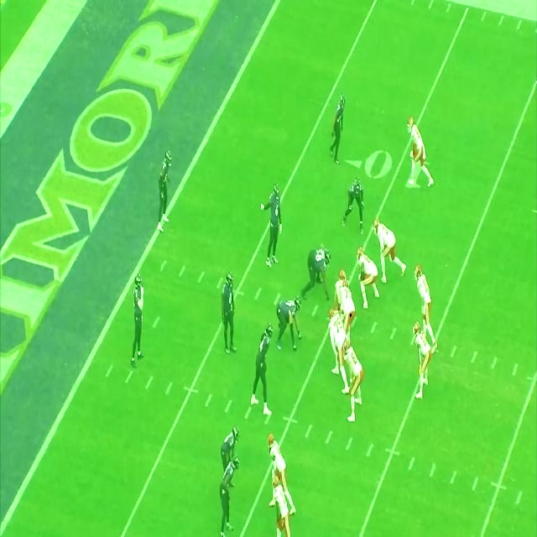
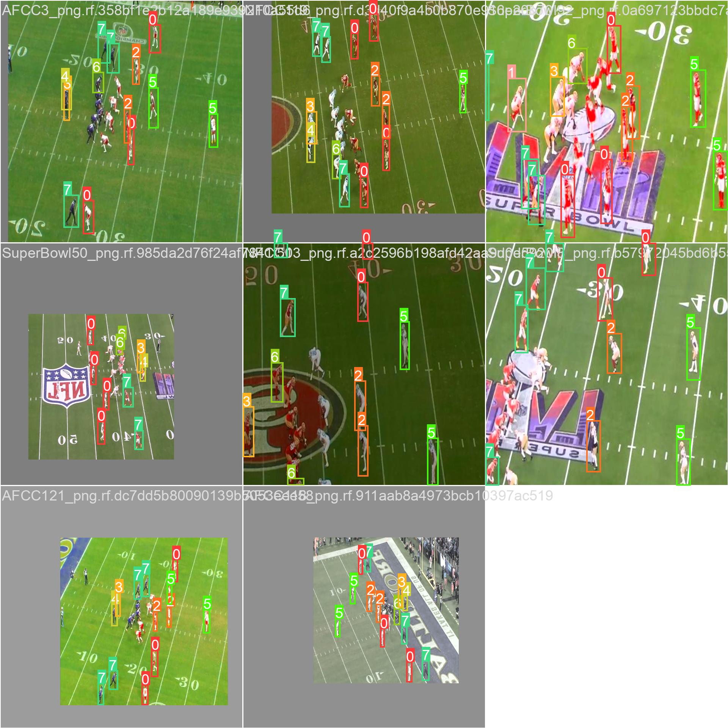
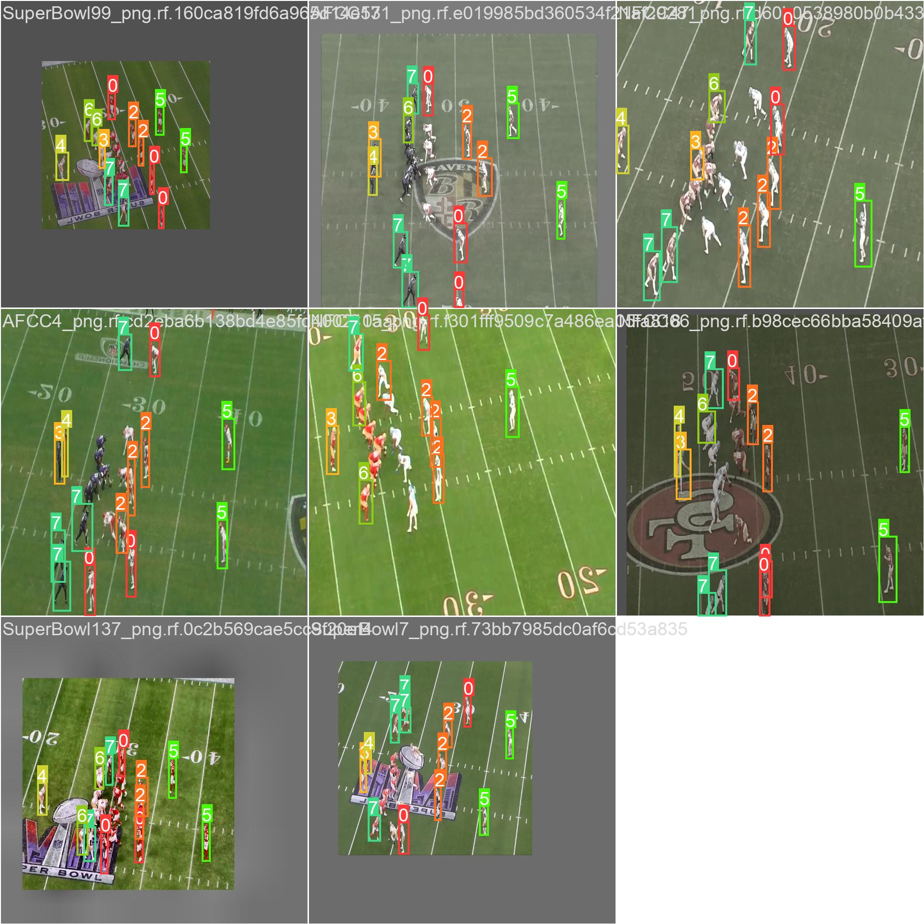
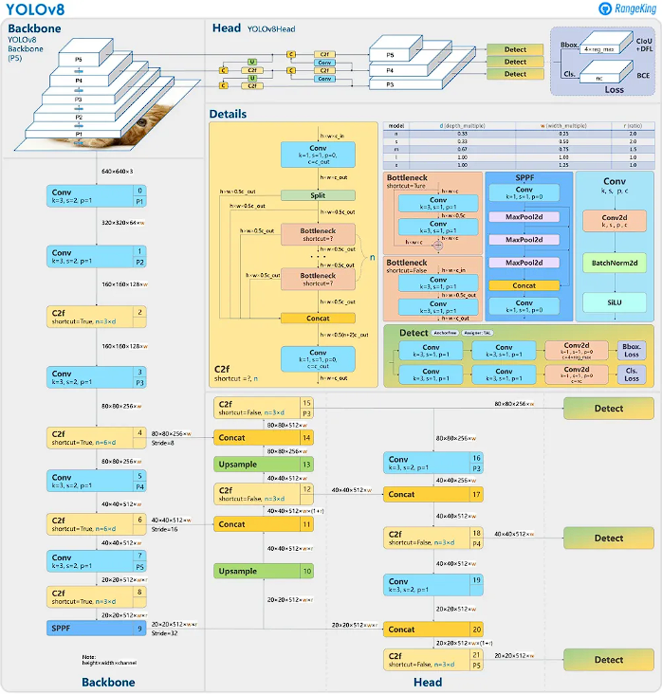
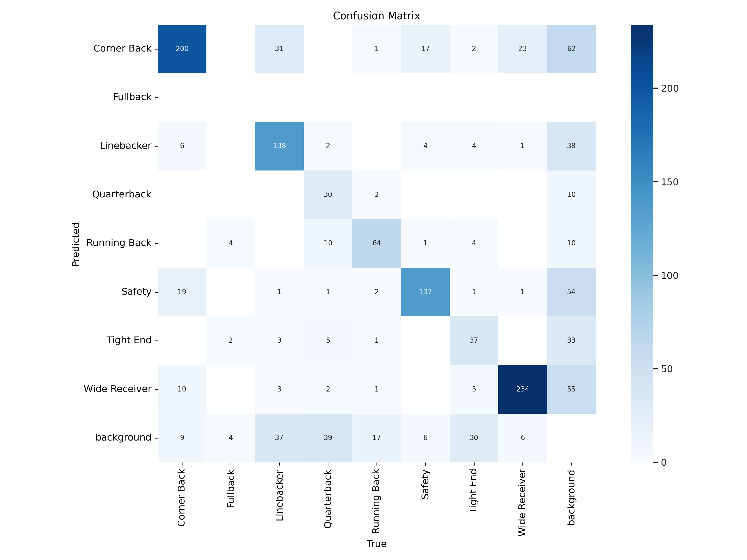
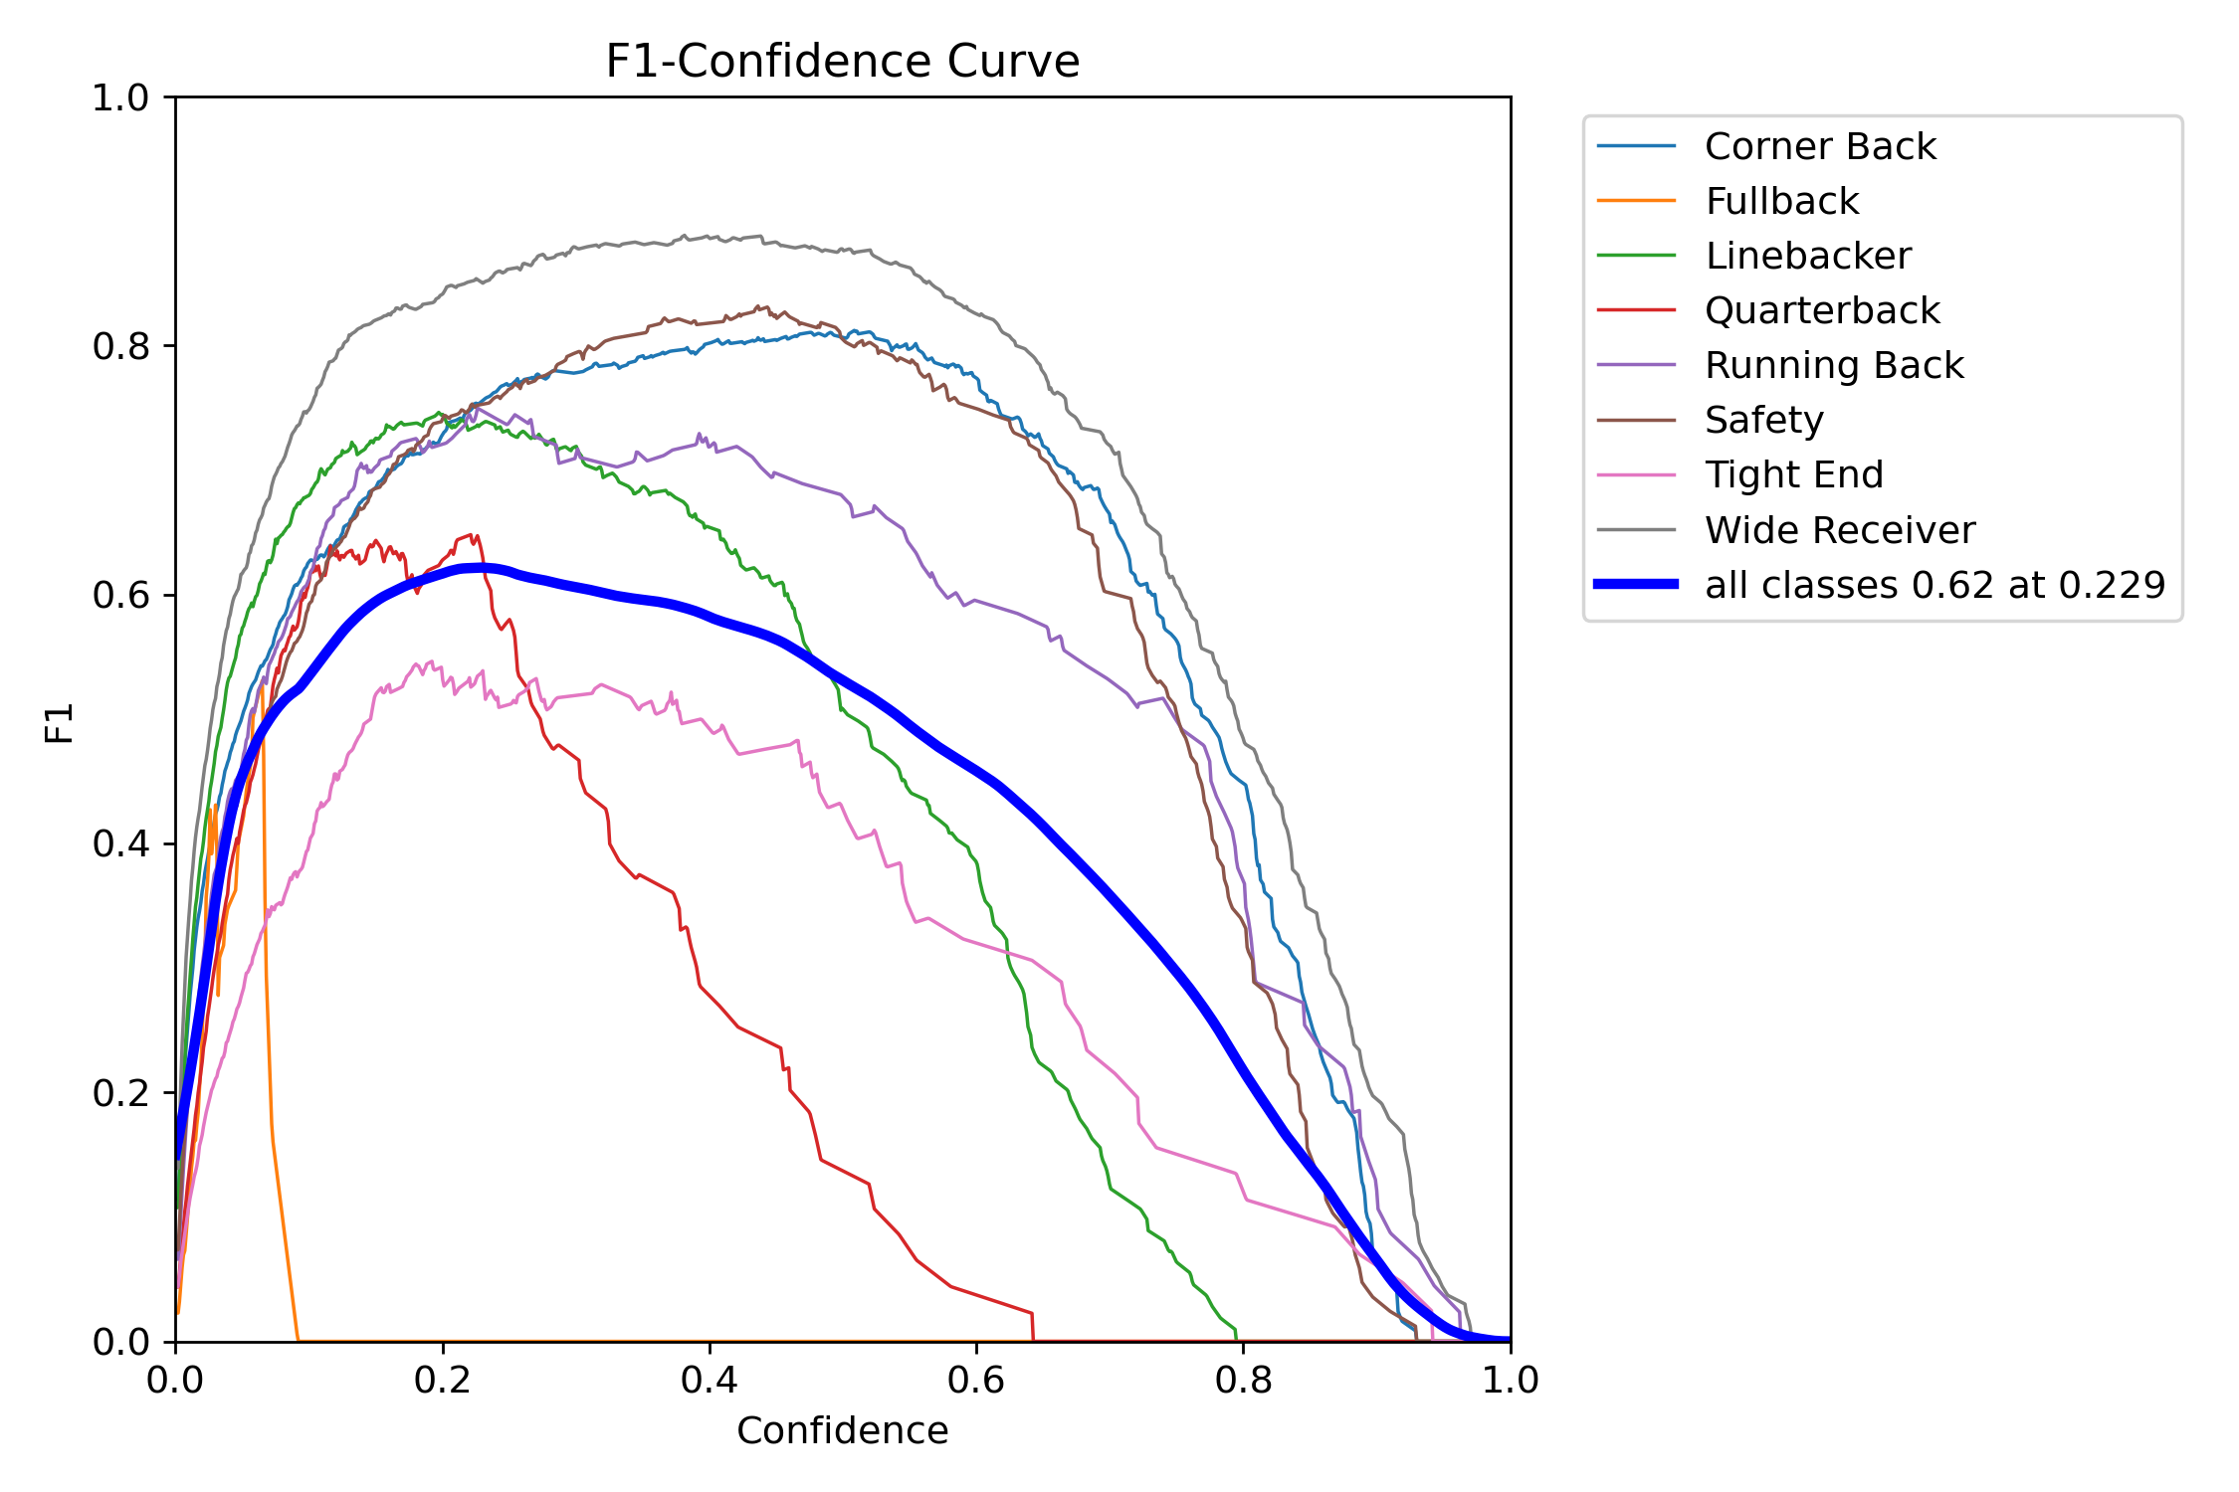
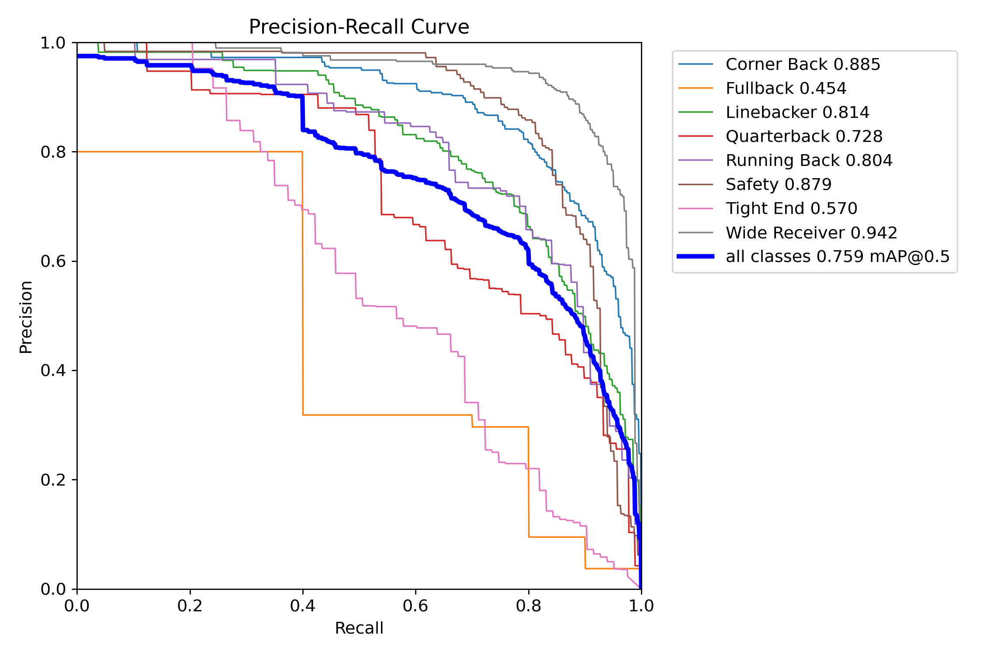
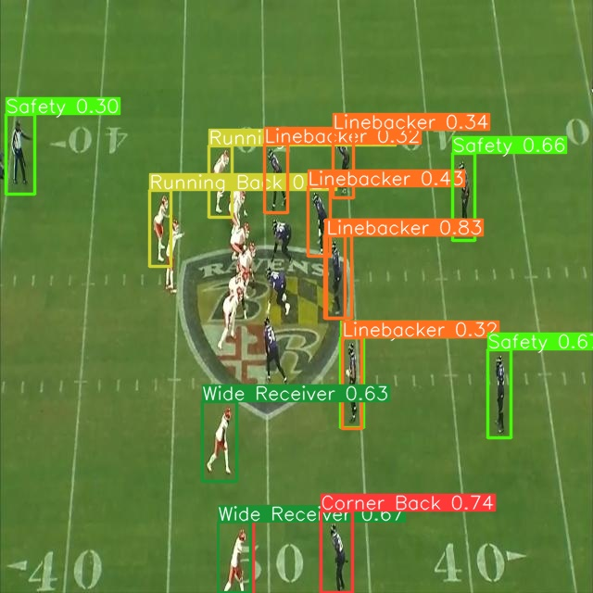
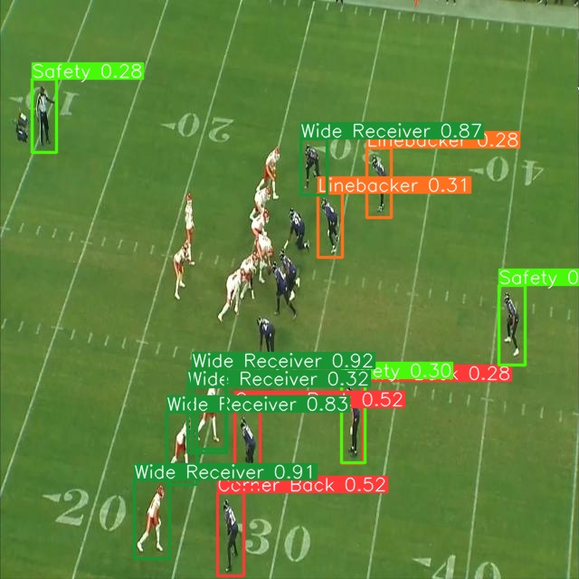
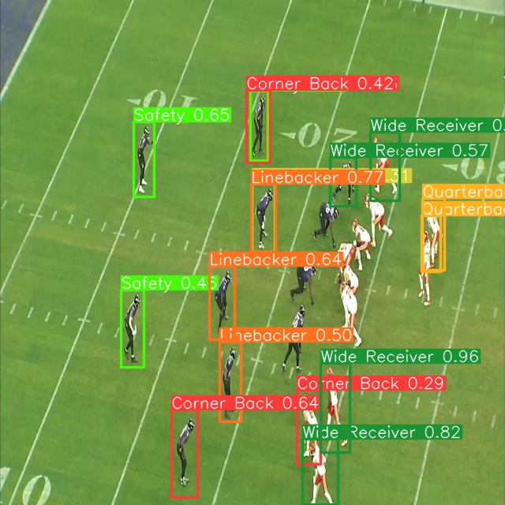
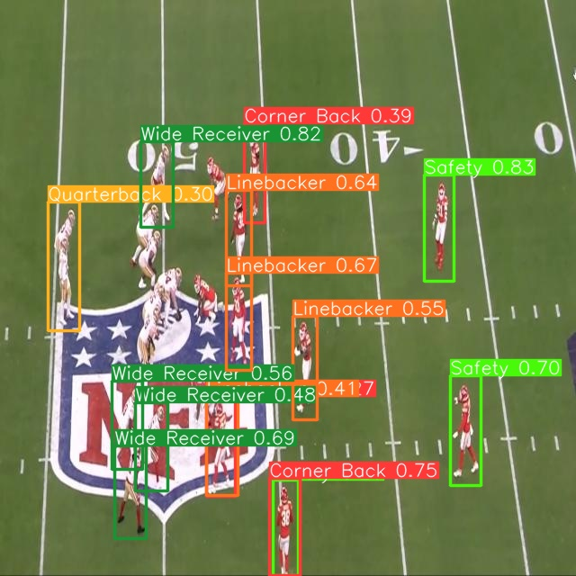
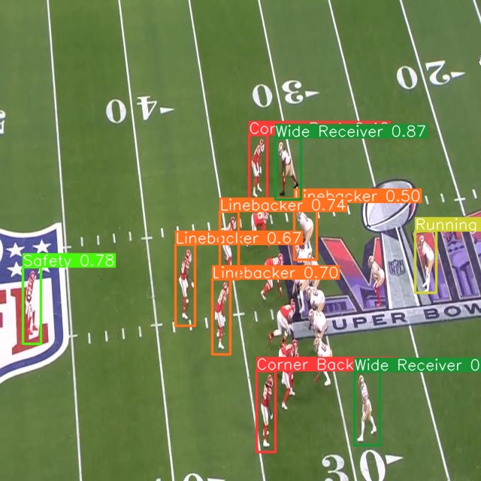
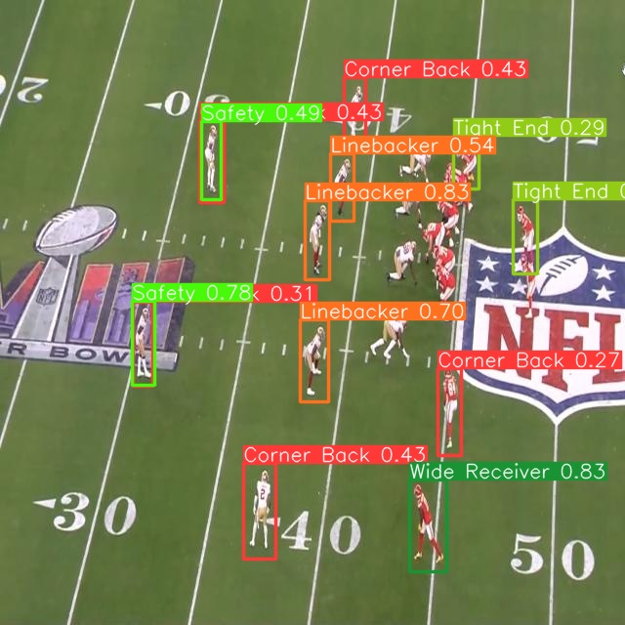
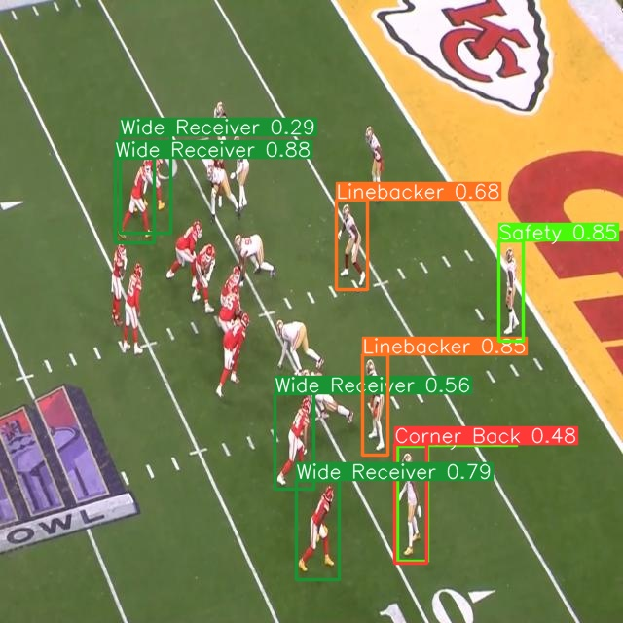
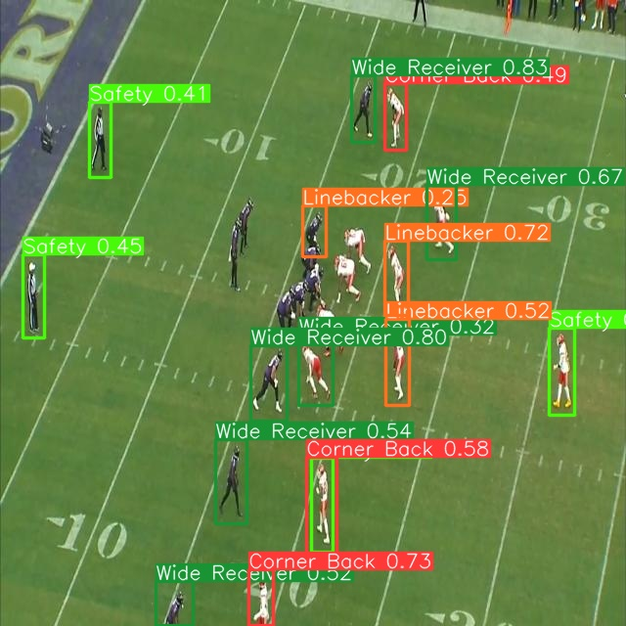
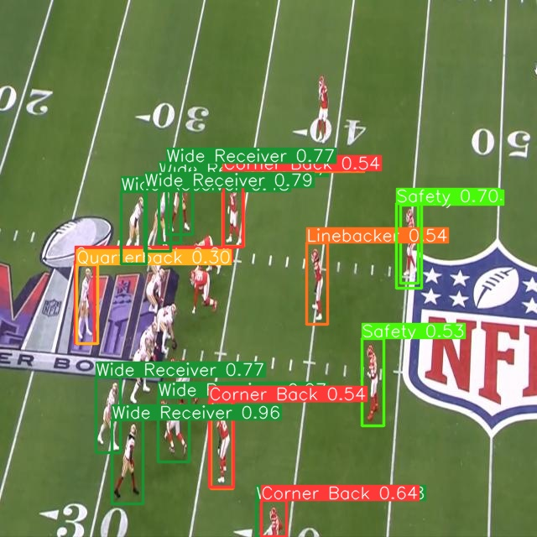
CSCI 1430
The Playmakers
John Michael Slezak, Atif Khan, Chenhao Lu, Ruida Zeng
Motivation
The first steps
Trial and error
Our initial motivation for making this project was that we wanted to be able to use image recognition to identify wide-receivers and then use video recognition to identify offensive plays that the wide-receivers make.
1. Getting images of NFL plays Our data consists of images at the start of offensive NFL plays from the 2024 NFC and AFC championship games and the Super Bowl.
2. Labeling Images
We used Roboflow software to help us label 503 images for our custom dataset. We labeled each position using bounding boxes.
At first, we just used the pre-trained YOLO model weights and got varying results. We tried using a color-matching methodology as well as an object-detection strategy. The results weren’t what we were looking for, however. The performance of the color matching algorithm was harmed by the players poses and background noises.
Attempted Filtering Solution
Key Insights That Lead to Solution
More details. Explain how it works.
In order improve the color-matching methodology’s performance, we wrote a script that computes a customized filter to every image and then applied them. The goal was to remove background noises caused by the NFL logos, team logos, or the end zone colors. This performed poorly since different teams and different fields have different noise colors.
To optimize the performance of our model, we implemented the YOLO algorithm tailored it to the custom dataset that we specifically designed. The dataset was structured to train the neural network weights with a focus on identifying and classifying objects based on their positions within the images. This approach was crucial for enabling the model to generate reliable outcomes, and without importing and utilizing this dataset, the desired results would not be attainable.
YOLO utilizes a unique architecture that processes the entire image in a single pass, which is critical for capturing contextual relationships between objects. This capability is especially beneficial in dynamic environments like NFL games, where understanding the interactions and positions of players in real-time is crucial. By analyzing the whole scene at once, YOLO not only detects individual players but also understands their spatial relationships, helping to accurately localize and classify each player amidst the rapidly changing conditions of the game.
Results (images/figures)
More results
We utilized our model and weights on a brand-new dataset containing NFL game footage to further test the accuracy of our object detection model. Each image, like the one provided, showcases the model's ability to identify and classify players according to their positions on the field. The players are encapsulated within bounding boxes, with labels containing their position on the field along with confidence scores reflecting the model's certainty in its predictions. The results we see are fairly accurate (as demonstrated in the confusion matrix, precision curve, and confidence curve). In reviewing the results, we identified several areas that could be improved upon in future studies. This includes correcting logical inconsistencies observed, such as the misclassification of a safety positioned on the offensive side or the identification of multiple quarterbacks in a single play. These issues highlight potential areas for refining the accuracy of our model.
References
Acknowledgements
[1] Juan Du. Understanding of object detection based on cnn family and yolo. Journal of Physics: Conference Series, 1004(1):012029, apr 2018. 1
[2] Jana, Arka Prava, Biswas Abhiraj, and Mohana. Yolo based detection and classification of objects in video records. 2018 3rd IEEE International Conference on Recent Trends in Electronics and Information and Communication Technology, 2018. 1
[3] Peiyuan Jiang, Daji Ergu, Fangyao Liu, Ying Cai, and Bo Ma. A small-object-detection model based on improved yolov8 for uav aerial photography scenarios. Sensors, 2023. 1
We would like to thank Joel Manasseh, Srinath Sridhar, and Siddharth Diwan for their help and guidance.

